Slide 1
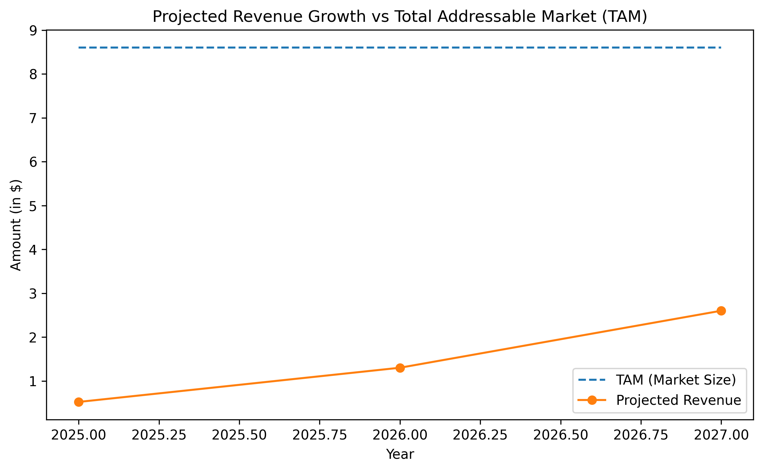
Massive Market Opportunity With Clear Revenue Path
TAM of $8.6B globally with a reachable SOM of $13M in 3 years
Even capturing <1% of SAM drives meaningful revenue growth
Strong economic justification for investment and scaling

Slide 2
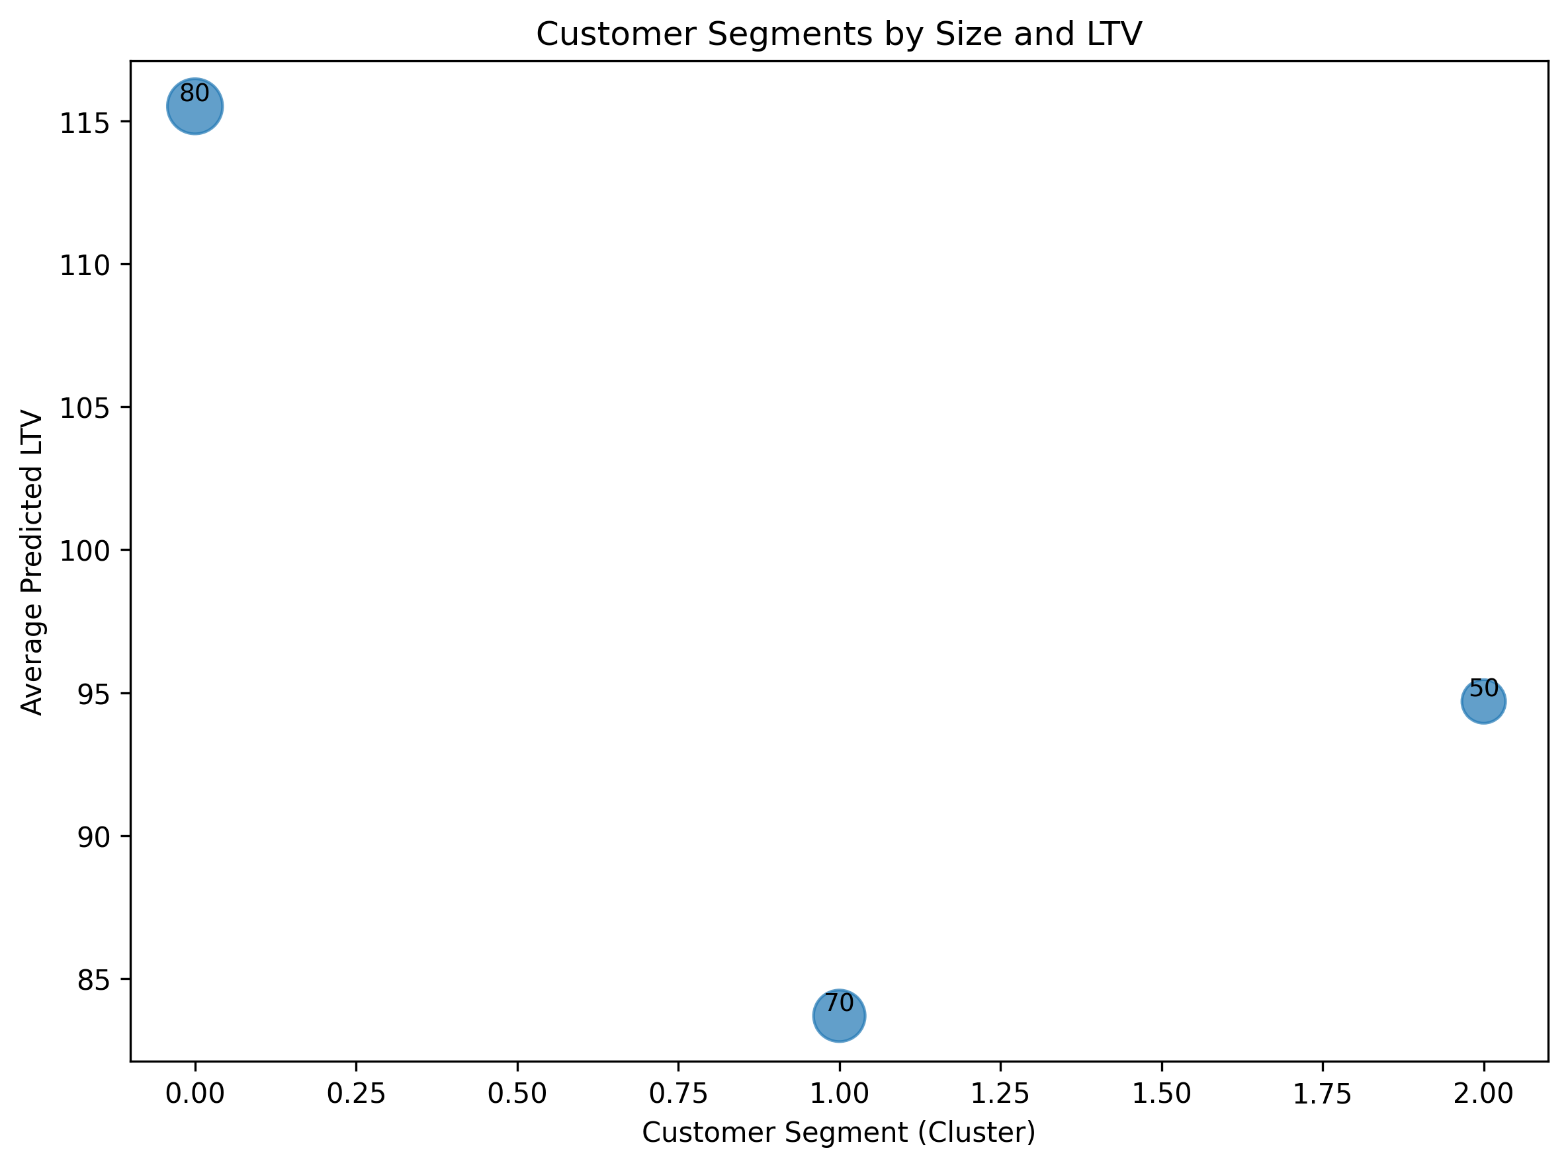
High-Value Segments Drive Revenue Efficiency
Largest customer segment also shows highest predicted LTV
Prioritizing this group increases retention & monetization efficiency
Segment-based strategy supports fast sustainable scaling

Slide 3
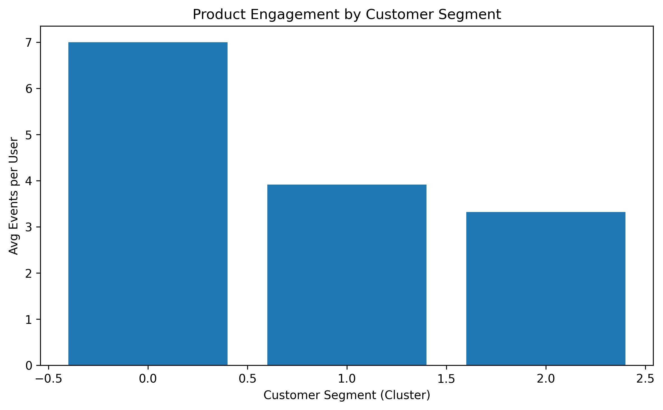
Engaged Users Show Strong Product-Market Fit
Key segments interact with the product 3–5× more frequently
Indicates strong adoption behavior and real workflow dependence
Engagement depth creates defensibility & switching cost

Slide 4
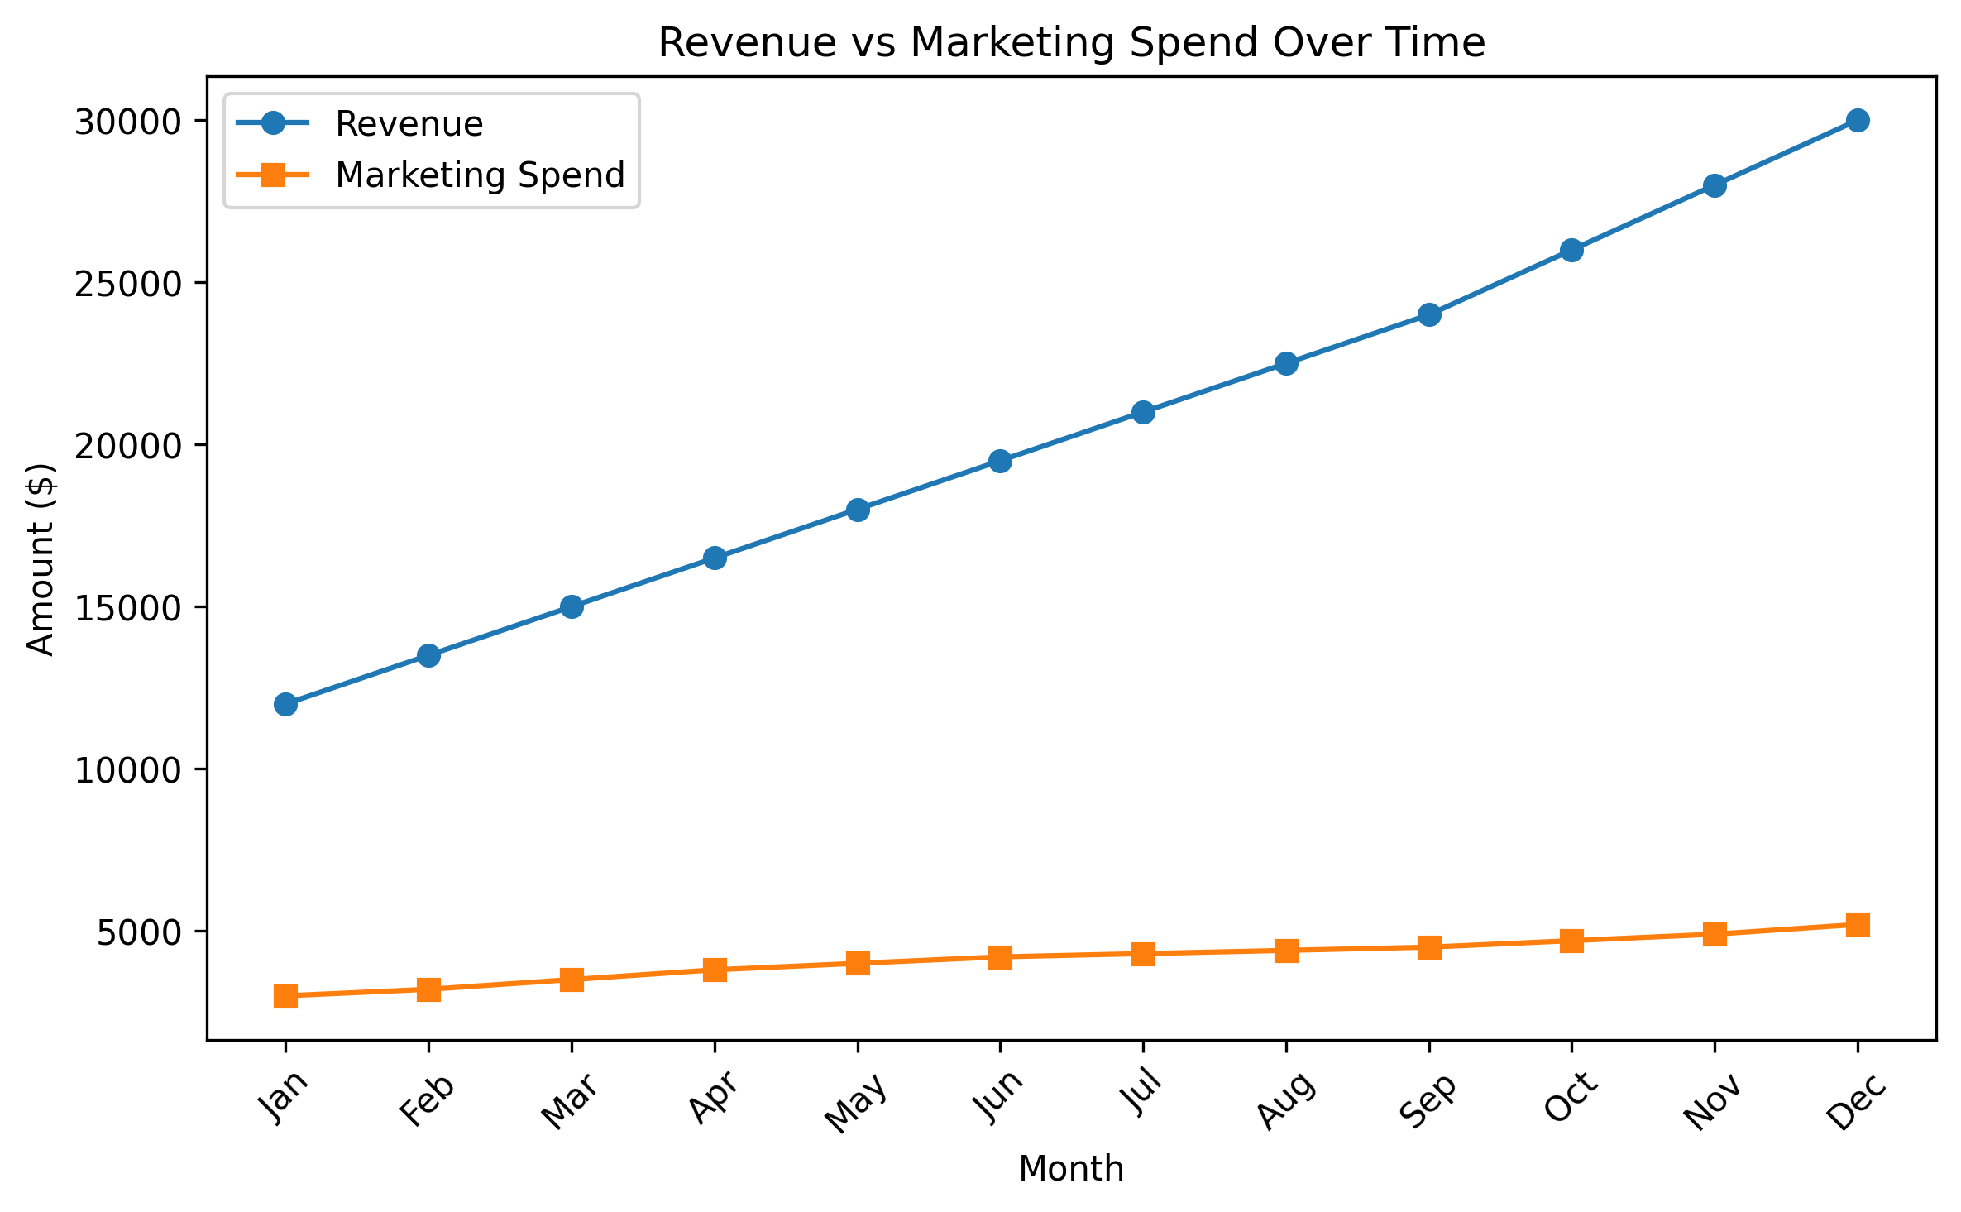
Efficient Growth with Improving Unit Economics
Revenue beginning to separate from marketing cost
Demonstrates efficient CAC recovery path
Supports scalable & profitable growth strategy

Slide 5
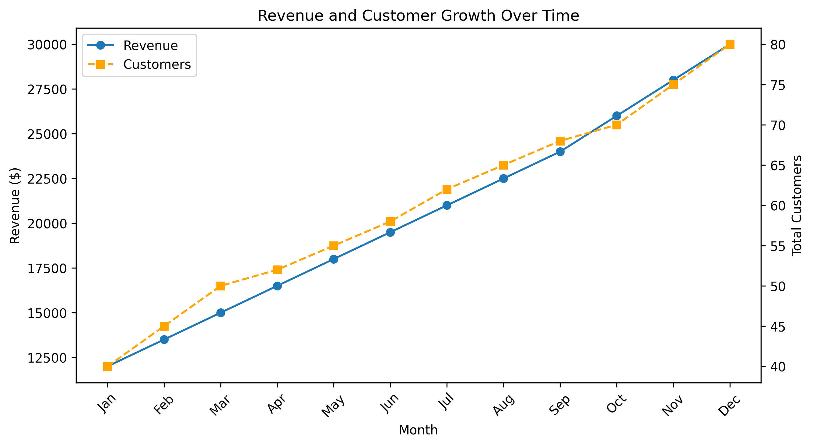
Data-Driven Roadmap Aligned With Revenue Potential
Feature roadmap based on LTV and impact prioritization
Focused execution plan accelerates monetization
Clear phased GTM approach

